Slide 1
IPv6 Host IP Addressing
Julian
CPE SW1
ZyXEL
March 14, 2008

Slide 2
Abstract
Introduction to how the host get IPv6 address by “Stateless Address Auto configuration”.

Slide 3
Outline
Terminology
Introduction to IPv4 and IPv6
IPv6 address architecture
Protocol
  ICMPv6
  Neighbor Discovery IPv6
  IPv6 stateless address autoconfiguration
Example of NEC NTA IPv6 addressing
References

Slide 4
Outline
Terminology
Introduction to IPv4 and IPv6
IPv6 address architecture
Protocol
  ICMPv6
  Neighbor Discovery IPv6
  IPv6 stateless address autoconfiguration
Example of NEC NTA IPv6 addressing
References

Slide 5
Terminology
Node: a device that implements IP.
Router : a node that forwards IP packets not explicitly addressed to itself.
Host : any node that is not a router.
Path MTU : smallest MTU in the path between two hosts.
link-layer address : like Ethernet MAC address.

Slide 6
Outline
Terminology
Introduction to IPv4 and IPv6
IPv6 address architecture
Protocol
  ICMPv6
  Neighbor Discovery IPv6
  IPv6 stateless address autoconfiguration
Example of NEC NTA IPv6 addressing
References

Slide 7
Introduction to IPv4 and IPv6
Basic Header Format : IPv4 and IPv6
Differences:
  Basic header
  Extension header
  Function

Slide 8
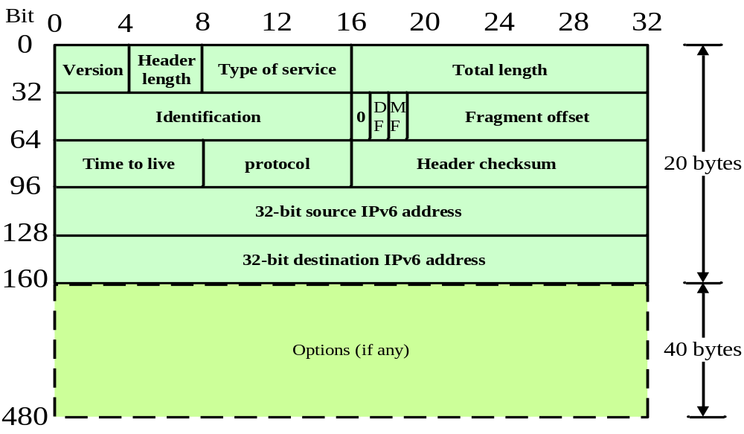
IPv4 Header
Notes:
Version: 4
Header length: 32-bit word, usually 5 indicate 20 (4*5) , 0~60 bytes
TOS: DSCP (Differentiated Services Code Point (DSCP) ), classify layer 3 packet priority
Total length: include header
ID: different ID and for fragmentation and reassembly.
DF: don’t fragment MF: more fragment
Fragment offset: 13 bits (a byte count) , if 1480 = 0xb9->185->x8 -> 20b9
Time to live: number of router through which a datagram can pass
Protocol: next header.
Haeader checksum: 16-bit one-comp

Slide 9
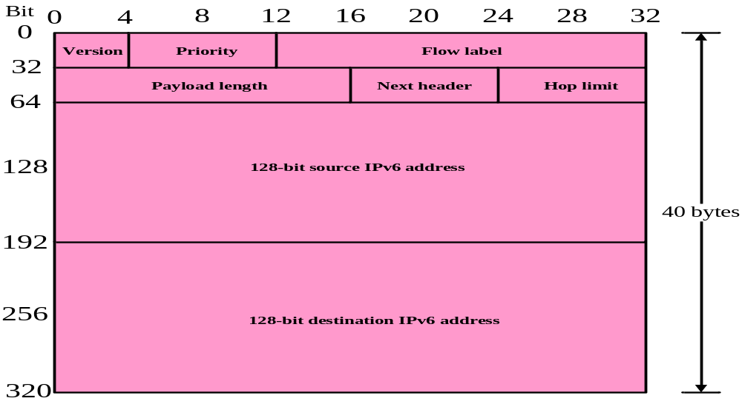
IPv6 Header
Notes:
Priority -> traffic class , like IPv4 TOS
Flow label: some packets use to know the flow
Payload length: the include header
Next header: like IPv4 protocol
Hop limit: like IPv4 TTL

Slide 10
Basic Header Difference
Enlarge the size of IP address field from 32-bit to 128-bit.
Simplify IPv6 header
  No header length field (fixed header size)
  No fragmentation field
  No checksum field
Speed up processing on 64-bit architectures.

Slide 11
Extension Header
The Use of Extension Headers
IPv6 Header
Next Header
= TCP
TCP Header +
Data
IPv6 Header
Next Header
= Routing
Routing Header
Next Header
= TCP
TCP Header +
Data
IPv6 Header
Next Header
= Routing
Routing Header
Next Header
= Fragment
Fragment Header
Next Header
= TCP
TCP Header +
Data

Slide 12
Extension Header (cont’d)
Six Type of Extension Headers
  Hop-by-Hop Options Header
  Routing Header
  Fragment Header
  Destination Options Header
  Authentication Header
  Encapsulating Security Payload Header

Slide 13
Extension Header (cont’d)
Recommended Order:
  IPv6 Header
  Hop-by-Hop Options Header
  Destination Options Header (1)
  Routing Header
  Fragment Header
  Authentication Header
  Encapsulating Security Payload Header
  Destination Options Header (2)
  Upper-layer Header

Slide 14
Function Difference
No broadcast.
Multicasting is mandatory.
Support anycast.
IPv6 routers do not fragment packets they forward. Fragmentation is performed by Host.
Support authentication and security option.
Support Path MTU discovery.

Slide 15
Outline
Terminology
Introduction to IPv4 and IPv6
IPv6 address architecture
Protocol
  ICMPv6
  Neighbor Discovery IPv6
  IPv6 stateless address autoconfiguration
Example of NEC NTA IPv6 addressing
References

Slide 16
IPv6 Address Architecture
Notation of IPv6 Addresses
Addresses Type

Slide 17
IPv6 Address Architecture
Notation of IPv6 addresses
Addresses type

Slide 18
Notation of IPv6 Addresses
Format: x:x:x:x:x:x:x:x , where the 'x's are the hexadecimal values of the eight 16-bit pieces of the address.
    FEDC:BA98:7654:3210:FEDC:BA98:7654:3210
    1080:0:0:0:8:800:200C:417A
Special syntax "::" to compress the zeros.
  The "::" can only appear once in an address.
    1080:0:0:0:8:800:200C:417A
    → 1080::8:800:200C:417A
    0:0:0:0:0:0:0:0
    → ::
    2001:0DB8:0000:0056:0000:0000:EF12:1234
    2001:DB8::56::EF12:1234 ?
    2001:DB8:0:56::EF12:1234 or 2001:DB8::56:0:EF12:1234

Slide 19
Notation of mixed environment of IPv4 and IPv6 nodes
Format: x:x:x:x:x:x:d.d.d.d
  'x's are the hexadecimal values of the six high-order 16-bit pieces of the address
  'd's are the decimal values of the four low-order 8-bit pieces of the address
    0:0:0:0:0:0:13.1.68.3
    → ::13.1.68.3

Slide 20
Notation of Address Prefixes
ipv6-address/prefix-length
  12AB:0000:0000:CD30:0000:0000:0000:0000/60
  12AB::CD30:0:0:0:0/60 (O)
  12AB:0:0:CD30::/60 (O)
  12AB:0:0:CD3/60 (X)
  12AB::CD30/60 (X)
  12AB::CD3/60 (X)
When writing both a node address and a prefix of that node address
  the node address 12AB:0:0:CD30:123:4567:89AB:CDEF
  its subnet number 12AB:0:0:CD30::/60
  → 12AB:0:0:CD30:123:4567:89AB:CDEF/60

Slide 21
IPv6 Address Architecture
Notation of IPv6 addresses
Addresses type

Slide 22
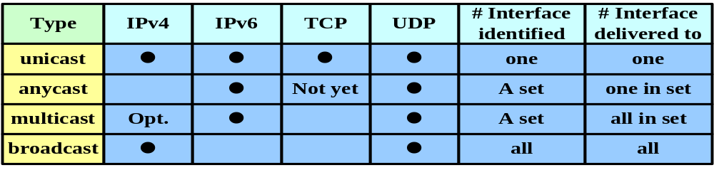
Address Type
Unicast
  Uniquely identifies an interface of an IPv6 node
Multicast
  Identifies a group of IPv6 interfaces
Anycast
  Assigned to multiple interfaces (usually on multiple nodes)
  A packet sent to an anycast address is delivered to only one of these interfaces, usually the nearest one.

Slide 23
Address Type - Unicast
Global Unicast Addresses
Local-use IPv6 Unicast Addresses
  Link- local unicast
  Site- local unicast
IPv6 Addresses with Embedded IPv4 Addresses

Slide 24
Global Unicast Addresses (RFC 3587)
n bits
m bits
128–m-n bits
global routing prefix
subnet ID
interface ID
n bits
64-n bits
64 bits
global routing prefix
subnet ID
interface ID
3
45 bits
16 bits
64 bits
001
global routing prefix
subnet ID
interface ID
EUI-64 format :
  2000::/3
  Assignable Global Unicast Address space

Slide 25
Local-use IPv6 Unicast Addresses
Link- local unicast address : FE80::/10
10 bits
54 bits
64 bits
1111111010
0
interface ID
Site - local unicast address : FEC0::/10
10 bits
54 bits
64 bits
1111111011
Subnet ID
interface ID

Slide 26
Local-use IPv6 Unicast Addresses
Link- local unicast address :
  addressing on a single link
    automatic address configuration
    neighbor discovery
    when no routers are present.
Site- local unicast address
  addressing inside of a site without the need for a global prefix.
Routers must NOT forward any packets with both link-local and site-local source or destination addresses outside of the link or site.

Slide 27
IPv6 Addresses with Embedded IPv4 Addresses
IPv4-compatible IPv6 address (deprecated)
80 bits
16 bits
32 bits
0000………………….………0000
0000
IPv4 address
IPv4-mapped IPv6 address
80 bits
16 bits
32 bits
0000………………….………0000
FFFF
IPv4 address

Slide 28
Address Type - Multicast
8 bits
4 bits
4 bits
112 bits
0 reserved
1 interface-local scope
2 link-local scope
3 reserved
4 admin-local scope
5 site-local scope
6 (unassigned)
7 (unassigned)
8 organization-local scope
9 (unassigned)
A (unassigned)
B (unassigned)
C (unassigned)
D (unassigned)
E global scope
F reserved
11111111
000T
Scope
Group ID
T: 0 permanently-assigned by IANA
T: 1 non-permanently-assigned
Scope:

Slide 29
Pre-Defined Multicast Addresses
Reserved Multicast Addresses
  FF00:: ~ FF0F::
All Nodes Addresses
  FF01::1 (interface-local)
  FF02::1 (link-local)
All Routers Addresses
  FF01::2 (interface-local)
  FF02::2 (link-local)
  FF05::2 (site-local)
Solicited-Node Address (MLDv2)
  FF02:0:0:0:0:1:FFXX:XXXX
  →(FF02:0:0:0:0:1:FF00::/104)

Slide 30
Address Type - Anycast
n bits
128-n bits
Subnet prefix
0000…0000
An anycast address must NOT be used as the source address of an IPv6 packet.
An anycast address must NOT be assigned to an IPv6 host, that is, it may be assigned to an IPv6 router only.
Allocated from the unicast address space
Subnet-Router anycast address
  All routers are required to support
  Used for applications where a node needs to communicate with any one of the set of routers.

Slide 31
Address Types (cont’d)
Address Type | Binary Prefix | IPv6 Notation
Unspecified | 00...0 (128 bits) | ::/128
Loopback | 00...1 (128 bits) | ::1/128
Multicast | 11111111 | FF00::/8
Link-local unicast | 1111111010 | FE80::/10
Site-local unicast | 1111111110 | FEC0::/10
Global unicast | (everything else)

Slide 32
Outline
Terminology
Introduction to IPv4 and IPv6
IPv6 address architecture
Protocol
  ICMPv6
  Neighbor Discovery IPv6
  IPv6 stateless address autoconfiguration
Example of NEC NTA IPv6 addressing
References

Slide 33
Outline
Terminology
Introduction to IPv4 and IPv6
IPv6 address architecture
Protocol
  ICMPv6
  Neighbor Discovery IPv6
  IPv6 stateless address autoconfiguration
Example of NEC NTA IPv6 addressing
References

Slide 34
ICMPv6 basic
Purpose:
  Report errors
  Diagnostics
IPv6 next header value: 58
Two classes for ICMPv6 type:
  Error messages: 0~127
  Informational messages: 128~255

Slide 35
ICMPv6 Basic (cont’d)
Much more powerful than ICMP:
  Multicast group membership management
  Address resolution
  Neighbor Discovery (ND)
    Many functions…..

Slide 36
ICMPv6 Basic (cont’d)
General ICMPv6 Header Format
Type (1 byte)
Code (1 byte)
Checksum (2 bytes)
Message Body (variable)
…..
…..

Slide 37
ICMPv6 Basic (cont’d)
RFC 2463 (ICMP for IPv6):
- ICMPv6 error messages:
  1 Destination Unreachable
  2 Packet Too Big
  3 Time Exceeded
  4 Parameter Problem
- ICMPv6 informational messages:
  128 Echo Request
  129 Echo Reply

Slide 38
ICMPv6 Basic (cont’d)
RFC 2710 (Multicast Listener Discovery for IPv6):
  130 Multicast Listener Query
  131 Multicast Listener Report
  132 Multicast Listener Done
RFC 2461 (Neighbor Discovery for IPv6):
  133 Router Solicitation
  134 Router Advertisement
  135 Neighbor Solicitation
  136 Neighbor Advertisement
  137 Redirect
More……

Slide 39
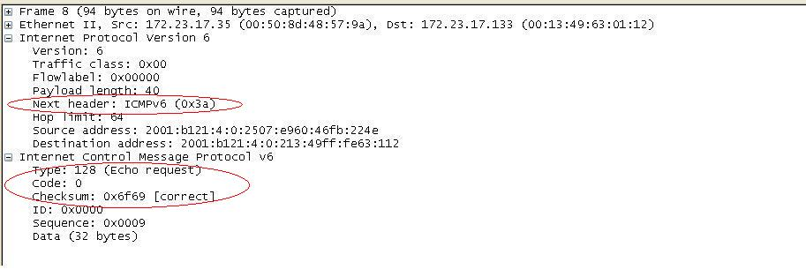
ICMPv6 Basic (cont’d)
Example 1

Slide 40
Outline
Terminology
Introduction to IPv4 and IPv6
IPv6 address architecture
Protocol
  ICMPv6
  Neighbor Discovery IPv6
  IPv6 stateless address autoconfiguration
Example of NEC NTA IPv6 addressing
References

Slide 41
Neighbor Discovery IPv6
Purpose
Protocol

Slide 42
Purpose
Combines ARP, ICMP
Solve the following problems :
  Router Discovery and Redirect
  Prefix/Parameter Discovery
  Address Autoconfiguration
  Address Resolution
  Neighbor Unreachability Detection (NUD)
  Duplicate Address Detection (DAD)
  Next-hop Determination
Notes:
Router Discovery: How hosts locate routers that reside on an
attached link.
Prefix Discovery: How hosts discover the set of address prefixes
that define which destinations are on-link for an
attached link. (Nodes use prefixes to distinguish
destinations that reside on-link from those only
reachable through a router.)
Parameter Discovery: How a node learns such link parameters as the
link MTU or such Internet parameters as the hop limit
value to place in outgoing packets.
Address Autoconfiguration: How nodes automatically configure an
address for an interface.
Address resolution: How nodes determine the link-layer address of
an on-link destination (e.g., a neighbor) given only the
destination's IP address.
Next-hop determination: The algorithm for mapping an IP destination
address into the IP address of the neighbor to which
traffic for the destination should be sent. The next-
hop can be a router or the destination itself.
Neighbor Unreachability Detection: How nodes determine that a
neighbor is no longer reachable. For neighbors used as
routers, alternate default routers can be tried. For
both routers and hosts, address resolution can be
performed again.
Duplicate Address Detection: How a node determines that an address
it wishes to use is not already in use by another node.
Redirect: How a router informs a host of a better first-hop node
to reach a particular destination.

Slide 43
Protocol
Five ICMPv6 packet types:
  Neighbor Solicitation (type 135)
  Neighbor Advertisement (type 136)
  Router Solicitation (type 133)
  Router Advertisement (type 134)
  Redirect (type 137)
ND Option Format
Notes:
Redirect : Used by a router to inform hosts of a better first hop for a destination

Slide 44
NS and NA
The pair of NS and NA messages:
  duplicate address detection (DAD)
  determine the link-layer address of a neighbor. (Address resolution)
  neighbor unreachability detection (NUD)
Unsolicited NA message:
  Inform neighboring nodes of changes in link-layer addresses or the node's role
When IPv6 destination address of NS is
  Multicast: DAD or address resolution
  Unicast: verify the reachability of a neighbor (NUD)

Slide 45
NS and NA (cont’d)
Neighbor Solicitation Packet Format
Type
(1 byte)
135
135 = Neighbor Solicitation
Code
(1 byte)
Unused
0
Checksum
(2 bytes)
Reserved
(4 bytes)
The IP address of the target of the solicitation. MUST NOT be multicast.
Target Address
(16 bytes)
Options
(variable)
Possible options: source link-layer address

Slide 46
NS and NA (cont’d)
Neighbor Advertisement Packet Format
Type
(1 byte)
136
136 = Neighbor Advertisement
Code
(1 byte)
0
Unused
Checksum
(2 bytes)
R = router flag
S = solicited flag
O = override flag
All other reserved for future use
(4 bytes)
R
S
O
Target Address
(16 bytes)
Options
(variable)
Possible options: target link-layer address

Slide 47
RS and RA
Hosts send Router Solicitation messages to prompt routers to respond immediately.
  discover the presence of IPv6 routers on the link
Routers send out the Router Advertisement messages periodically.
  determine the link prefixes (Prefix Information)
  the link MTU
  whether or not to use address autoconfiguration
  addresses valid time and preferred time.

Slide 48
RS and RA (cont’d)
Router Solicitation Packet Format
Type
(1 byte)
133
133 = Router Solicitation
Code
(1 byte)
Unused
0
Checksum
(2 bytes)
Reserved
(4 bytes)
Options
(variable)
Possible options: source link-layer address

Slide 49
RS and RA (cont’d)
Router Advertisement Packet Format
Type
(1 byte)
134
134 = Router Advertisement
Code
(1 byte)
Unused
0
Checksum
(2 bytes)
Cur Hop Limit
(1 byte)
M = managed address config flag
O = other stateful config flag
All other reserved for future use
(1 bytes)
M
O
Router Lifetime
(2 bytes)
Reachable Time
(4 bytes)
Time in milliseconds a node is considered reachable
Retrans Timer
(4 bytes)
Time in milliseconds between retransmitting NS messages
Options
(variable)
Possible options: source link-layer address
MTU, prefix info.

Slide 50
ND Option Format
ND message include zero or more options.
Option Type:
  1 Source Link-Layer Address (NS,RS,RA)
  2 Target Link-Layer Address (NA, RD)
  3 Prefix Information (RA)
  4 Redirected Header (RD)
  5 MTU (RA)

Slide 51
Outline
Terminology
Introduction to IPv4 and IPv6
IPv6 address architecture
Protocol
  ICMPv6
  Neighbor Discovery IPv6
  IPv6 stateless address autoconfiguration
Example of NEC NTA IPv6 addressing
References

Slide 52
IPv6 stateless address autoconfiguration
Type of Autoconfiguration
How to Stateless Auto Configure an IPv6 address
  DAD(NS/NA)
  Determine What Information Should Be Autoconfigured (RS/RA)

Slide 53
Type of Autoconfiguration
Stateless
  Allow a host to generate its own address using a combination of locally available information and information advertised by routers (Router Advertisement messages).
Stateful
  Configuration is based on the use of a stateful address autoconfiguration protocol, such as DHCPv6, to obtain addresses and other configuration options.

Slide 54
How to Stateless Auto Configure an IPv6 address
Create a link-local address.
Verify its uniqueness on a link.
Determine what information should be autoconfigured.

Slide 55
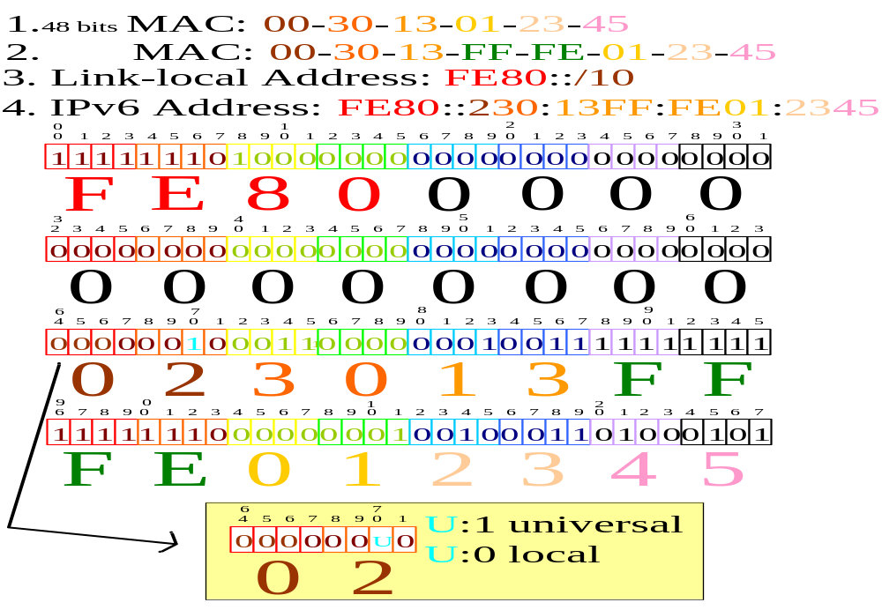
Create a link-local address

Slide 56
How to Stateless Auto Configure an IPv6 address
Create a link-local address.
Verify its uniqueness on a link.
Determine what information should be autoconfigured.

Slide 57
Verify its uniqueness on a link
By the algorithm of Duplicate Address Detection (DAD)
The Neighbor Solicitation message is sent by IPv6 hosts to discover the link-layer address of an on-link IPv6 node.
An IPv6 node sends the Neighbor Advertisement message in response to a Neighbor Solicitation message.
If another node is already using that address, it will return a Neighbor Advertisement, then indicate DAD Fails.

Slide 58
Neighbor Solicitation message
The IPv6 destination address of NS for DAD is Solicited-Node Multicast Address.

Slide 59
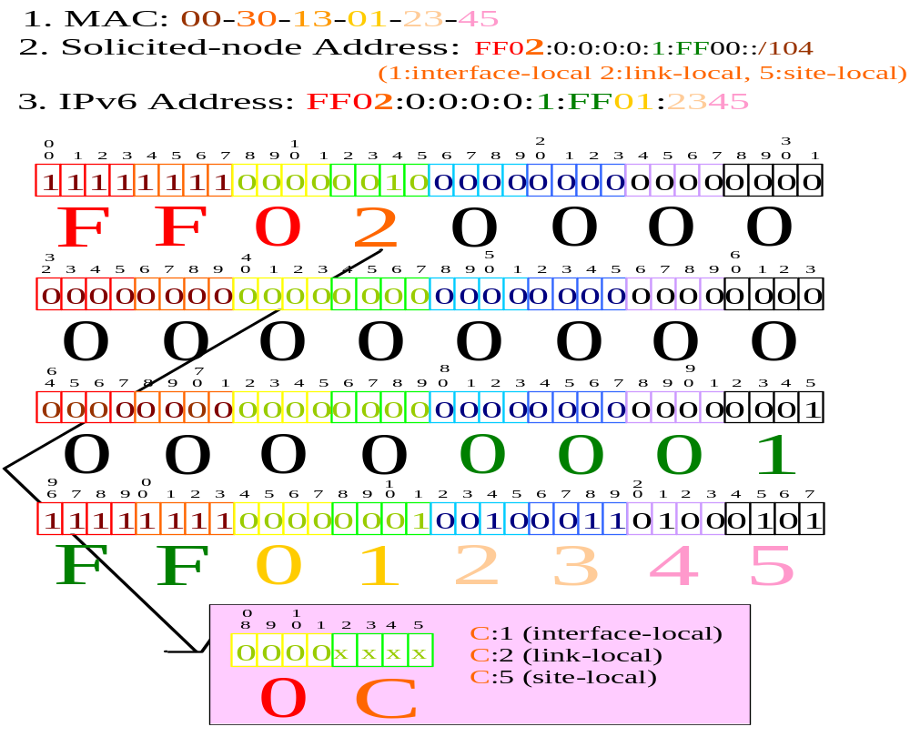
Solicited-Node Multicast Address

Slide 60
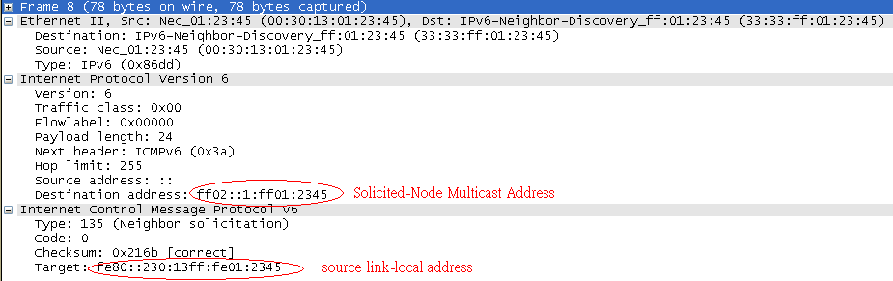
Neighbor Solicitation message

Slide 61
How to Stateless Auto Configure an IPv6 address
Create a link-local address.
Verify its uniqueness on a link.
Determine what information should be autoconfigured.

Slide 62
Determin what information should be autoconfigured
Using Router Solicitation Message to discover Router
  A host sends a multicast Router (FF02::2)
ICMPv6 message:
  Type:133, code:0.

Slide 63
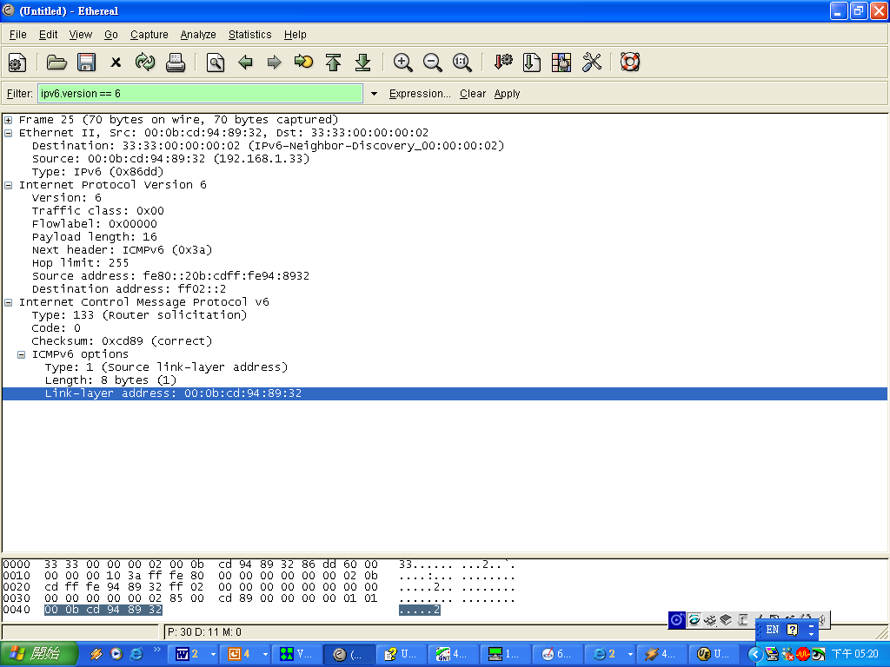
Router Solicitation messages
all-routers multicast address
The example doesn’t have the “Authentication Header.”
MUST NOT be included if the Source Address is the unspecified address. Otherwise it SHOULD be included on link layers that have addresses

Slide 64
Router Advertisement messages
ICMPv6 message:
  Type:134, code:0.
IPv6 routers send the Router Advertisement message:
  periodically
  in response to the receipt of a Router Solicitation message.
Router Advertisement message
  determine the link prefixes (Prefix Information)
  the link MTU
  specific routes
  whether or not to use address autoconfiguration
  addresses valid time and preferred time.

Slide 65
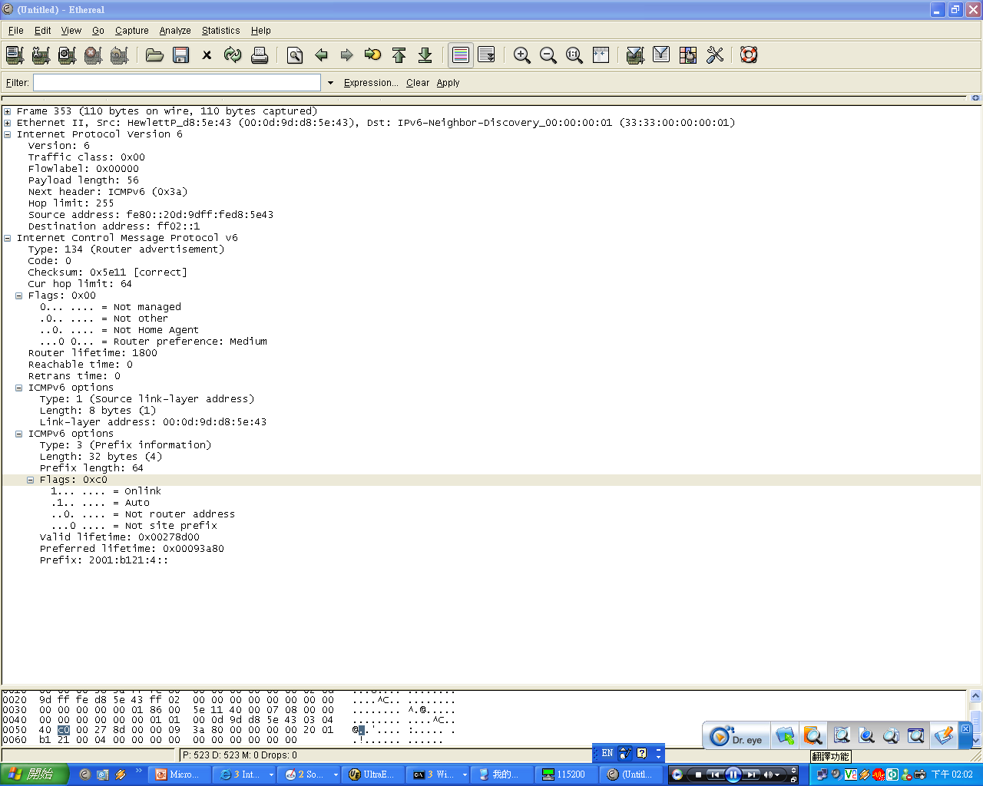
Router Advertisement messages
Source Address MUST be the link-local address assigned to the interface from which this message is sent.
Destination Address :Source Address of an invoking Router Solicitation or the all-nodes multicast address.
Hot limit must be 255
The example doesn’t have the “Authentication Header.”
M flag: whether hosts should use stateful autoconfiguration to obtain addresses
O flag: 2462:whether hosts should use stateful autoconfiguration to obtain additional information (excluding addresses)
draft-ietf-ipv6-2461bis-11 :other configuration information is available via DHCPv6
Router Lifetime : 0 indicates that the router is not a default router and SHOULD NOT appear on the default router list.
Reachable Time: milliseconds. Used by the Neighbor Unreachability Detection algorithm. A value of zero means unspecified (by this router).
Retrans Timer: milliseconds, between retransmitted NS. Used by address resolution and the Neighbor Unreachability Detection algorithm. A value of zero means unspecified (by this router).

Slide 66
Outline
Terminology
Introduction to IPv4 and IPv6
IPv6 address architecture
Protocol
  ICMPv6
  Neighbor Discovery IPv6
  IPv6 stateless address autoconfiguration
Example of NEC NTA IPv6 addressing
References

Slide 67
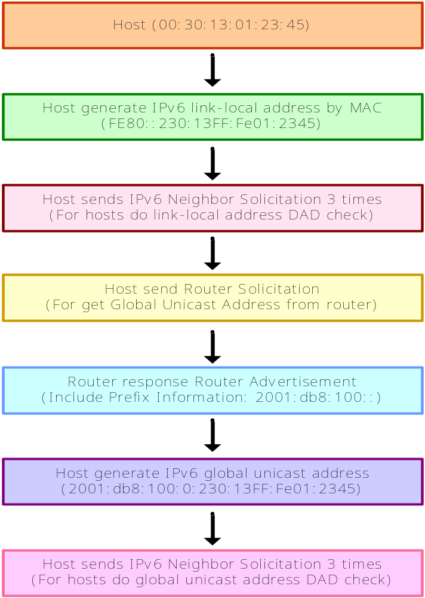
Example of NEC NTA IPv6 addressing

Slide 68
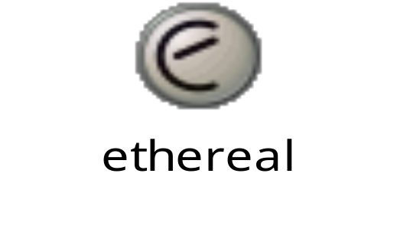
Example of NEC NTA IPv6 addressing
Packets captured log by Ethereal

Slide 69
Outline
Terminology
Introduction to IPv4 and IPv6
IPv6 address architecture
Protocol
  ICMPv6
  Neighbor Discovery IPv6
  IPv6 stateless address autoconfiguration
Example of NEC NTA IPv6 addressing
References

Slide 70
References
RFC 2460 – “IPv6 Specification”
RFC 3513 – “IPv6 Addressing Architecture”
RFC 2463 – “ICMPv6”
RFC 2461 – “Neighbor Discovery for IPv6”
RFC 2462 – “IPv6 Stateless Address Autoconfiguration”
RFC 3587 – “IPv6 Global Unicast Address Format”

